Slide 1
Changing the conversation on mental health
Paul Farmer, Chief Executive
mind.org.uk

Slide 2
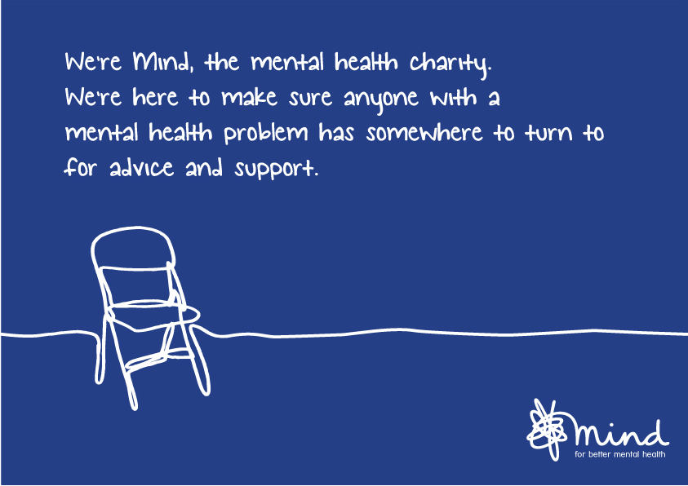

Slide 3
We give advice and support
Through our network of over 140 local services, we reach over 400,000 people each year
We offer:
- Counselling - Debt advice
- Training - Employment services
- Supported housing - Advocacy
- Art therapy - Ecotherapy

Slide 4
140+ local Minds across England and Wales
440,000 people supported
Combined income of c£97m
2,500 staff and 7,000 volunteers
More than 1100 trustees
People living with mental health problems involved in the running of all local Minds

Slide 5
We listen and understand
Our online peer support network has over 10,000 users
Over 6.5 million visits to our website
Our helplines respond to 50,000 calls annually

Slide 6
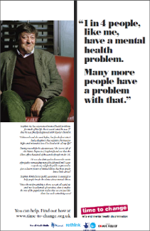
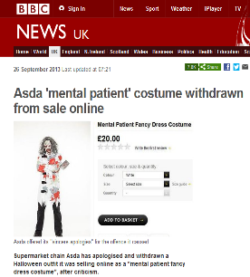
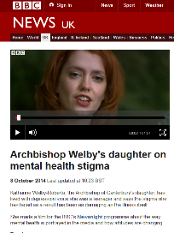
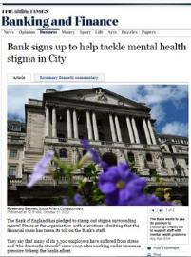
We speak out
Notes:
Campaign
Improve services
raise awareness
Promote understanding

Slide 7
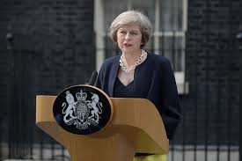
Mental health on the political agenda
-Teresa May ‘there is not enough help to hand for people with mental health problems’ in her first speech as PM.
-Jeremy Hunt continues as the Secretary of State for Health but is now also personally responsible for mental health. This sends a strong message that mental health will be high on the political agenda

Slide 8
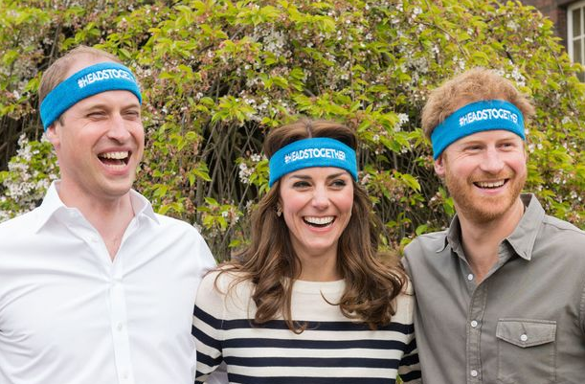
Reaching new audiences
Notes:
Heads Together will be the 2017 Virgin Money London Marathon Charity of the Year, giving the new charity a chance to step up its fundraising and awareness campaign.
The eight charities that make up Heads Together are:
the Anna Freud Centre
Mind
Place2Be
Best Beginnings
Campaign Against Living Miserably
Contact
The Mix
YoungMinds.

Slide 9
Mental health is everyone’s business

Slide 11
We all have mental health
1 in 4 people will experience a mental health problem in any given year
Mental ill health is indiscriminate
By 2020, depression will be the second most common cause of ill health worldwide
Notes:
Mental health is described by WHO as- a state of wellbeing in which every individual realizes his or her own potential, can cope with the normal stresses of life, can work productively and fruitfully, and is able to make a contribution to her or his community- World Health Organisation
75 per cent of people with common mental health problems receive no appropriate treatment
Cost of mental health to society is £105 billion
Demand is rising – but mental health spending fell by 8.25 per cent (£60m) in last Parliament

Slide 12
But people don’t talk about it…

Slide 13
Silence around issue
Scared to reveal problem
Lack of knowledge
Stigma
Those with mental health problems
Wider
society
Increases perception of stigma
Scared to raise the issue
Silence around issue

Slide 14
Time to Change programme
England’s biggest programme to end the stigma and discrimination faced by people with mental health problems
Run by Mind and Rethink Mental Illness and funded by the Department of Health, Comic Relief and the Big Lottery Fund
Notes:
8.3% improvement in attitudes 2008-2015 for the adult programme
3% reduction in discrimination

Slide 16
People more willing to speak out
Greater priority for mental health support
Greater knowledge and awareness
Fundamental shift in how we view mental health
Empowerment
Greater media interest
Greater political interest
Greater public interest
Stronger voice for mental health sector
Notes:
Tackling stigma can create a virtuous circle of empowerment
Increases the chance people will seek help if they become unwell, can change people’s expectations about mental health.

Slide 17
Living with stigma is often worse than the illness itself…

Slide 18
Time to Change poll data
Stigma and discrimination faced by an individual with a mental health problem is often worse than the illness itself:
60% of people said that stigma and discrimination are as damaging or more damaging than the symptoms of their mental health problem
35% of respondents said that stigma had made them give up on their ambitions, hopes and dreams for their life
27% said stigma had made them want to give up on life

Slide 19
Stigma in the workplace…
Notes:
Nearly 9 out of 10 people have been affected by stigma and discrimination
Two-thirds of people have stopped doing things because of stigma they face- applying for jobs, making new friends, going out to pubs and shops
It can even prevent people from reporting crime

Slide 20
What is the current picture in workplaces?

Slide 21
Mental health at work
Right now 1 in 6 workers is dealing with anxiety, depression or stress
Work is the most stressful factor in people’s lives
40 per cent of employers view workers with mental health problems as a ‘significant risk’

Slide 22
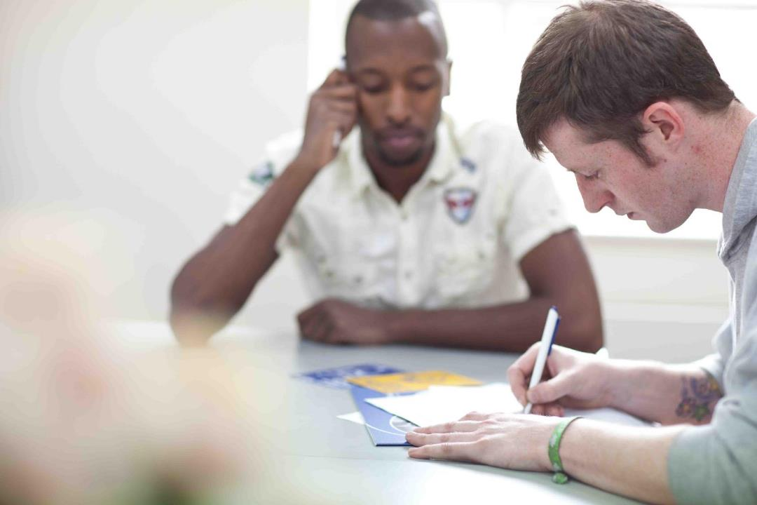
What are the causes?
Issues with management
Excessive workload and unrealistic targets
Not enough support from colleagues
Job insecurity

Slide 23
Work/life balance
1 in 5 felt work has put a strain on their relationship
11% had missed important events like birthdays and weddings
13% check work emails when out with family
24% have been contacted by their employer while on holiday
53% said it had affected their sleep
36% experience Sunday night blues

Slide 24
Culture of silence
Eight in ten employers have no mental health policy to help staff sustain good mental health
1 in 5 workers have called in sick due to stress but 95% gave a different reason to their boss
Managers want to do more to improve staff mental wellbeing
Staff would feel more loyal and committed if their employer took action on staff wellbeing
So employers need to take the first step and make it a priority

Slide 25
Where do we need to get to?
Our goal is to mainstream good mental health and make it core business for all employers
Everyone is supported to have good mental health at work, no matter where they are on the spectrum
People get appropriate support when they are experiencing a mental health problem
“Open and supportive workplaces benefit everyone – employees, employers and the bottom line”

Slide 26
Where next?
Health & Safety or Health, Wellbeing & Safety?
Diversity & Equality
What does good look like?
Benchmarking
Boardroom Issue

Slide 27
How to create a mentally healthy workplace…

Slide 28
Promote wellbeing
A comprehensive mental health strategy will create an open
and supportive working environment
Three-pronged approach
Promote wellbeing
Tackle work-related mental health problems
Support employees with mental health problems
Senior leadership across the organisation is crucial
Notes:
In order to create a mentally healthy workplace, you need to implement a comprehensive approach that
Promotes wellbeing for all staff
Tackles the work-related causes of MHPs
Supports staff experiencing a MHP across the spectrum
Senior leadership is key to this

Slide 30
Promote wellbeing
Get mental health on the agenda and build mental health literacy
Strong leadership – positive, open and clear culture which values staff
Support flexible working where possible
Promote open dialogue and involve staff in decision-making
Invest in your staff
Promote physical and social activities
Encourage peer support and buddy systems
Notes:
30

Slide 31
Tackling the causes
Routinely take stock of organisation’s mental health and wellbeing
Organisational level
Team level
Individual level
Ensure line managers are supported and confident on mental health
Organise work efficiently and effectively and clearly communicate responsibilities and expectations
Consider the physical environment
Publicise internal and external support
Notes:
31

Slide 32
Supporting employees
Develop tailored support for individuals when needed. A useful tool is developing an Action Plan that covers:
What keeps you well at work
Workplace triggers and early warning signs
Impact of mental health problem on performance
Steps for the line manager to take
Steps for the individual to take
Put in place support measures and workplace adjustments
Notes:
32

Slide 33
What can you do for your team?
Lead by example
Build your confidence on mental health
Normalise mental health
Take stock
Be available to your staff
Treat people as individuals and don’t judge
Embed employee engagement
Create opportunities for coaching, learning and development
Promote positive work relationships
Raise awareness
Notes:
33

Slide 34
How do I know if someone needs support?

Slide 35
Potential indicators
Changes in people’s behaviour or mood or how they interact with colleagues
Changes in their work output, motivation levels and focus
Struggling to make decisions, get organised and find solutions to problems
Appearing tired, anxious or withdrawn and losing interest in activities and tasks they previously enjoyed
Changes in eating habits or appetite
Increased smoking or drinking
Notes:
35

Slide 37
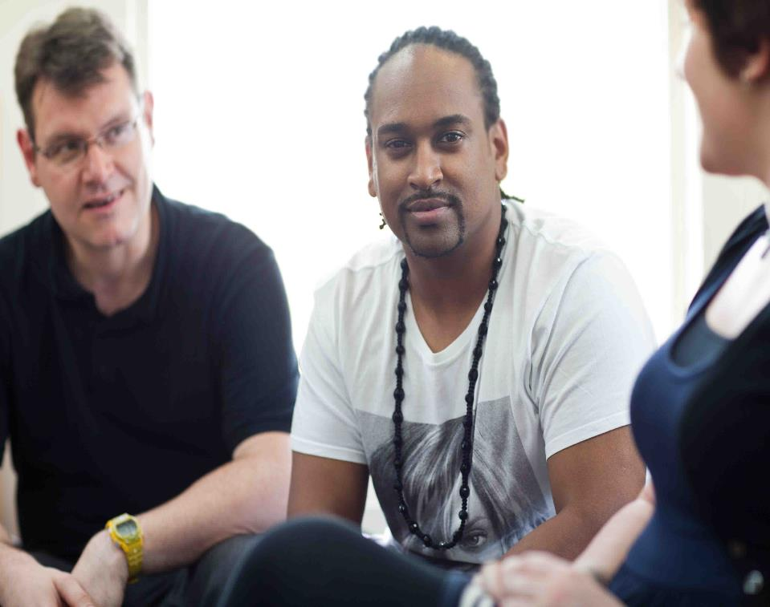
How to take care of your own mental health…

Slide 38
Building your resilience
Do stuff to boost your wellbeing
Build social connections
Find ways to cope that work for you
Notes:
Boost your wellbeing
5 ways to wellbeing
Positive psychology → science of happiness
Build social connections
Friends and family → support system to draw on
Find ways to cope
Do you ruminate about the past or worry about the future? Mindfulness might be helpful
Are you quite critical of yourself? Being more compassionate to yourself and reflecting more on what you’ve done well can counter that
Do things bring you down a lot? Keeping a gratitude journal might help
Do you get stressed? Learn some relaxation techniques such as breathing exercises, listening to music
All of this is advanced common sense in a lot of ways but it’s about taking the time to do it and investing in yourself
38

Slide 39
Top tips at work
Take your lunch break and get some fresh air
Be honest if expectations are unrealistic
Make the most of supervisions and one-to-ones
Reflect on your achievements each day
Talk to colleagues, friends and family
If you are feeling overwhelmed…
Learn some relaxation techniques
Take a deep breath and some time out
Communicate if you need help
Notes:
39

Slide 40
Having a work/life balance
Are you often the last to leave work? Do you do extra work outside of working hours?
Create clear boundaries between work and home
Refresh your ‘to do’ list at the end of the day
Use the time on your commute home to wind down from work
Make sure you’re maintaining a life outside of work
Notes:
40

Slide 41
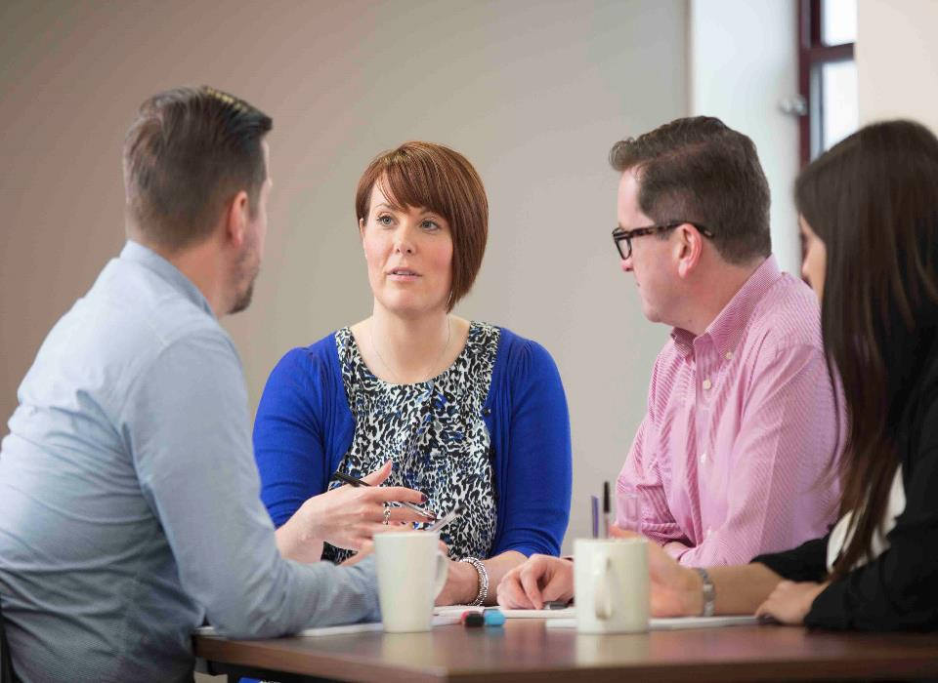
How we can help

Slide 42
Mind, Bank Workers Charity (BWC) & Lloyds Banking Group
Mind & BWC co-created a blended training programme with the goal of changing manager behaviours and the wider culture on the subject of mental health within call centres. This was piloted with 4 banks including LBG
This programme is now going to be extended with LBG to include:
Core programme – digital learning for all line managers
Enhanced programme - additional resources, face-to-face training and quarterly webinars for line managers
Train the trainer programme – to be rolled out
Peer-to-peer support – to be built into the
programme for achieve sustainability
Notes:
The programme was piloted in 4 banks over a 12 month period, including with Lloyds Banking Group and Bank of England
New programme
Core programme- Topics to include: promoting wellbeing within the organisation, identifying mental health problems, how to support staff, supporting your own wellbeing
Enhanced programme- Quarterly webinar sessions with Mind/BWC.
Train the trainer- Mind/BWC will also create a supporting training manual
Peer support- this will be provided either through webinars or the train the trainer programme

Slide 43
Workplace Wellbeing Index
Introducing our benchmark of best policy and practice in workplace mental health
On September 12 2016, we officially launched a public Index recognising good mental health policy and practice in workplaces across the UK and Channel Islands and providing guidance on how to improve
The Index will robustly assess where the gaps lie between an organisation’s approach and staff perceptions of mental health policy and practice

Slide 44
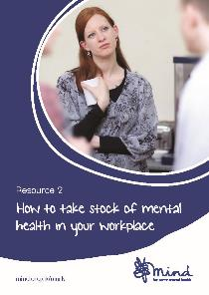
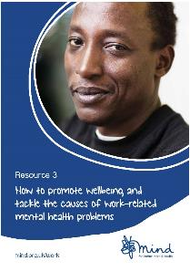
Resources for employers
Free e-newsletter with our latest updates
Free guides for employers

Slide 45
To find out more:
mind.org.uk/work for information and resources on mental health at work
mind.org.uk for general information
Contact: work@mind.org.uk 020 8215 2231
Notes:
45

